Slide 1
General Purpose Programmable Peripheral Devices
K.Jayachitra

Slide 2
General Purpose Programmable Peripheral Device
PPI – Programmable Peripheral Interface
It is an I/O port chip used for interfacing I/O devices with microprocessor.
Very commonly used programmable devices from Intel family are:
The 8255A peripheral interface.
The 8254 Interval Timer.
The 8294A Interrupt Controller.
The 8237 DMA controller.

Slide 3
The 8255A Programmable peripheral Interface
The parallel input-output port chip 8255 is also called as programmable peripheral input-output port.
The Intel’s 8255 is designed for use with Intel’s 8-bit, 16-bit and higher capability microprocessors.
It has 24 input/output lines which may be individually programmed in two groups of twelve lines each, or three groups of eight lines.
The two groups of I/O pins are named as Group A and Group B. Each of these two groups contains a subgroup of eight I/O lines called as 8-bit port and another subgroup of four lines or a 4-bit port.

Slide 4
The 8255A Programmable peripheral Interface
Thus Group A contains an 8-bit port A along with a 4-bit port C upper. The port A lines are identified by symbols PA0-PA7 while the port C lines are identified as PC4-PC7.
Group B contains an 8-bit port B, containing lines PB0-PB7 and a 4-bit port C with lower bits PC0- PC3.
The port C upper and port C lower can be used in combination as an 8-bit port C.
Both the port C are assigned the same address. Thus one may have either three 8-bit I/O ports or two 8-bit and two 4-bit ports from 8255.
All of these ports can function independently either as input or as output ports. This can be achieved by programming the bits of an internal register of 8255 called as control word register (CWR).

Slide 5
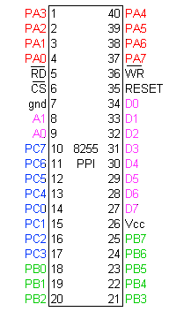

Slide 6
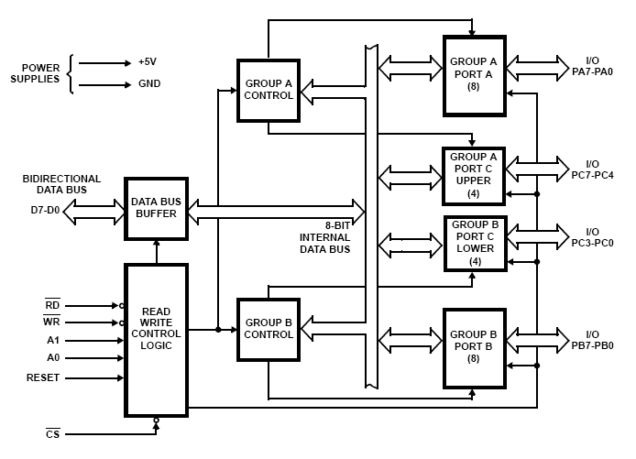
8255A Block Diagram

Slide 7
Function of pins
Data bus(D₀-D₇):These are 8-bit bi-directional buses, connected to 8085 data bus for transferring data.
Control Logic
RD (Read): This control signal is to enable read operation. When the signal is low activated, the MPU will read the data from certain I/O ports.
WR (Write): This signal enable the write operation. When this signal is at logic low, the MPU will write to I/O ports or control registers.
RESET (Reset): An active high signal. Use to clear the control register and sets all ports to input mode. Is connected to the RESET OUT pin of MPU.

Slide 8
Function of pins:
CS, A0 and A1: Signals to select device. CS is connected to a decoded address, whereas CS signal is a Master Chip Select, and A0 and A1 determine the input/output ports or control registers as
CS | A1 | A0 | Select
0 | 0 | 0 | PA
0 | 0 | 1 | PB
0 | 1 | 0 | PC
0 | 1 | 1 | Control reg.
1 | x | x | 8255A is not selected

Slide 9
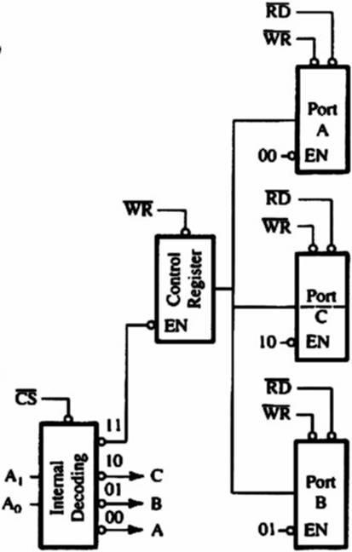
Expanded version of Control Logic and I/O Ports

Slide 10
Function of pins:
PA₀-PA₇:It is the 8-bit bi-directional I/O pins used to send the data to peripheral or to receive the data from peripheral.
PB₀-PB₇:Similar to PA
PC₀-PC₇:This is also 8-bit bidirectional I/O pins. These lines are divided into two groups.
PC₀ to PC₃(Lower Groups)
PC₄ to PC₇ (Higher groups)
These two groups working in separately using 4 data’s.

Slide 11
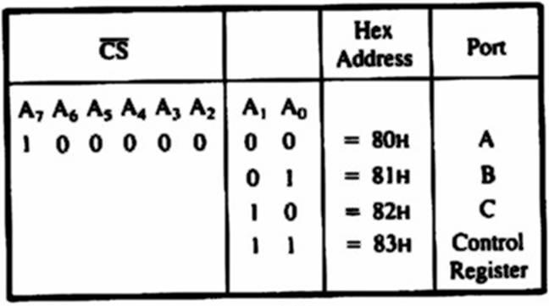
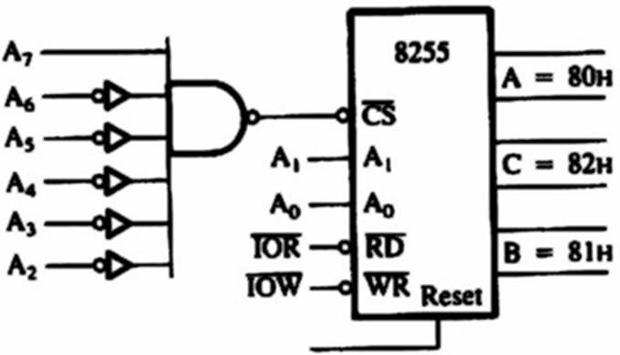
Example:
The port address is determined by CS, A₀ and A₁ pins.
CS is active low when A₇ = 1 and A₆ to A₂ are at logic 0.
When the signal is combined with A₀ and A₁, the port address is 80H to 83H as shown in Figure.

Slide 12
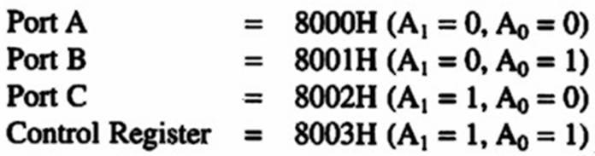
8255 PIA: Example
Solutions:
Port Address :
It is actually an I/O memory map.
When A₁₅ is active high, Chip Select signal is activated.
Assuming all don’t care signals are at logic 0, therefore ports’ address are as follows:
*

Slide 13
8255A
Control Word:
Figure shows the function of control register, the content in this register is known as Control Word which determines input/output ports.
This register is used to write control word when A0 and A1 are at logic 1.
Bit D7 in control register determines the I/O function or Set/Reset. If bit D7 = 1, bits D6-D0 determine the function of I/O in multiple modes.
Suppose bit D7 = 0, the port C operates in Bit Set/Reset (BSR) mode. The BSR control word does’t not cause any effect to port A and port B. The port C command register sets (1) or resets (0) the port C pins during mode 1 or mode 2 operation.

Slide 14
8255A
Three main concept to communicate to 8255:
Determine the port address of A, B and C using CS, A₁ and A₀.
Write control word in control register.
Write I/O instructions to communicate with ports.

Slide 15
8255 Programmable Peripheral Interface
The function of 8255 is categorized in two mode:
Set/Reset Bit (BSR) mode: The BSR mode is used to set or reset bit at port C.
I/O mode: The I/O is divided into 3 groups:
Mode 0, Mode 1 and Mode 2.
Mode 0, all ports function as input or output (I/O function).
Mode 1, is handshake mode, where port A and/or port B used port C as handshake bit.
Mode 2, port A can be used as bi-directional data transfer port with port C as handshake port and port B will be in mode 1 or mode 2.
*

Slide 16
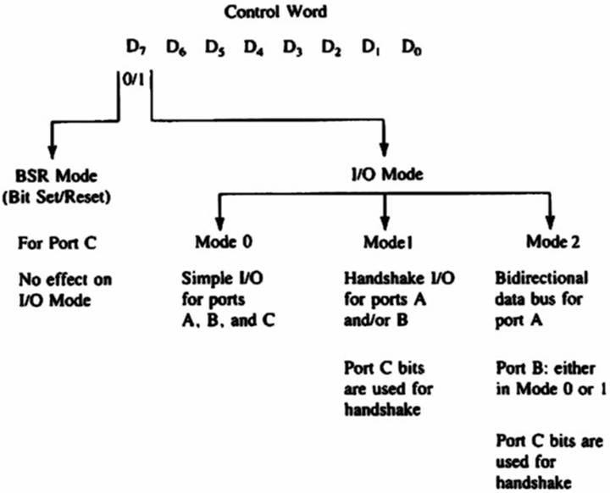
8255 PIA
*

Slide 17
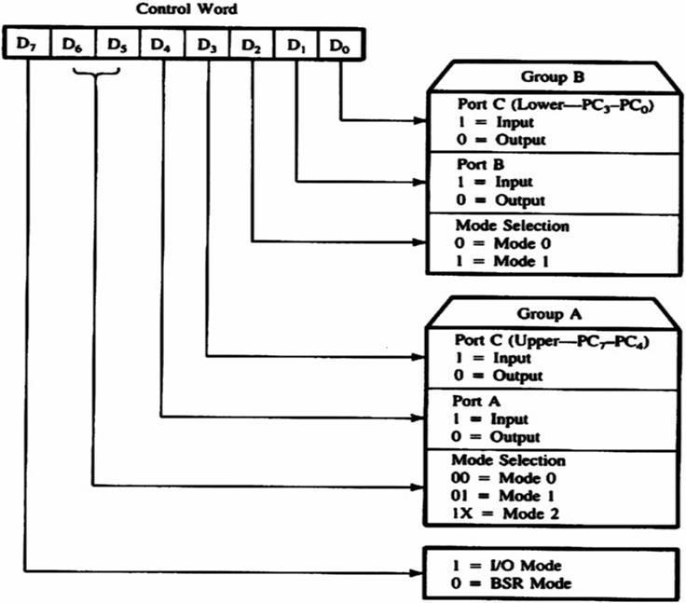
Functions of Control Word.

Slide 18
8255 PIA
BSR (Bit Set/Reset) mode
The BSR mode will only affect to port C.
Set/Reset can be determined by entering certain control word to control register.
No change to the previous data when D₇ change from 1 to 0; therefore the I/O ports A and B unchanged.
In BSR mode, the individual bit also can be used as ‘on / off’ switch.
*

Slide 19
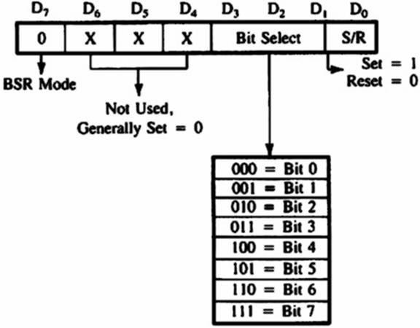
8255A Programmable Peripheral Interface
BSR Control Word.
The written control word in control register, set/reset will take only one bit at a time, as follows:
*

Slide 20

8255 PIA: BSR Mode
Example:
Write a BSR control word subroutine to set bit PC₇ and PC₃, and reset after 10ms. Use the schematic diagram as shown below.
*

Slide 21
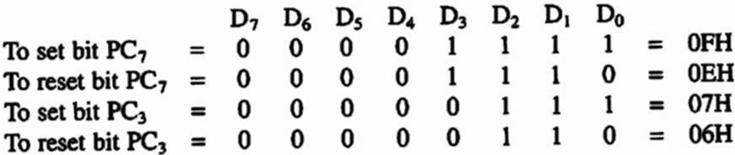
8255A Programmable Peripheral Interface
Solution:
BSR Control Word:
Port Address:
As shown in previous example : 83H
*

Slide 22
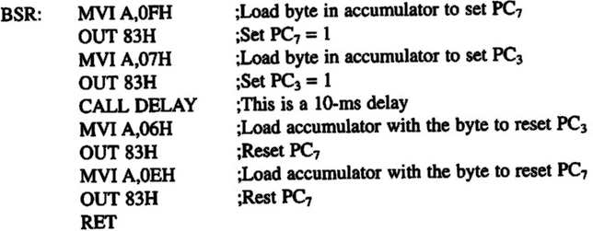
8255A Programmable Peripheral Interface
Solution:
Subroutine: Assuming that the delay subroutine has been determined earlier.
*

Slide 23
8255A Programmable Peripheral Interface
Mode 0: Input / Output Mode
In this mode port A and B use 8-bit I/O data and port C uses two ports 4-bit data.
The characteristics of mode 0 are:
Output is latched.
Input does not latched.
Ports do not have the capability of handshake mode or interrupt mode.
*

Slide 24
8255 PPI Contd.
Mode 1: Input or Output with Handshake: In this mode, handshake signals are exchanged between the MPU and peripherals prior to data transfer. The features of the mode include the following: 1. Two ports (A and B) function as 8-bit I/O ports. They can be configured as either as input or output ports.
2. Each port uses three lines from port C as handshake signals. The remaining two lines of Port C can be used for simple I/O operations.
3. Input and Output data are latched.
4. Interrupt logic is supported.
*

Slide 25
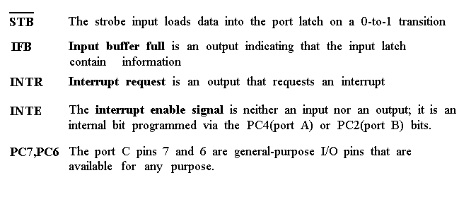
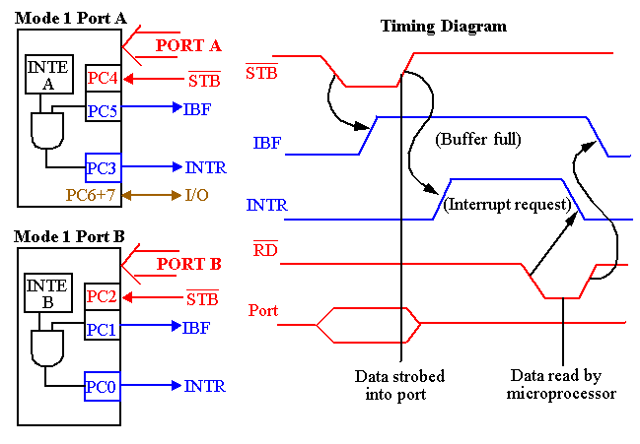
*

Slide 26
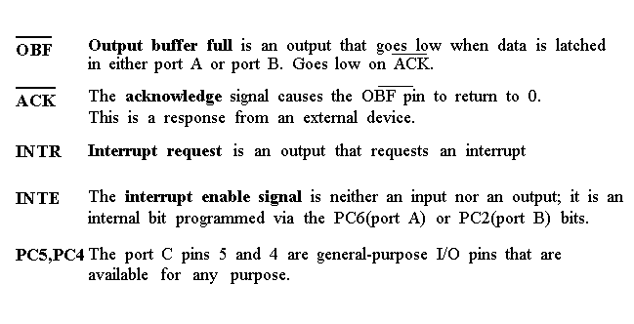
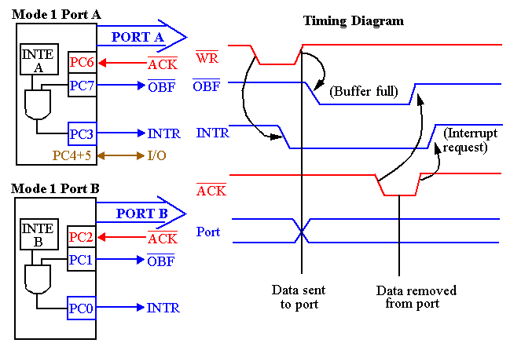
*

Slide 27
8255 PPI
Example:
The computer send the data to the printer large speed compared to the printer.
When computer send the data according to the printer speed at the time only, printer can accept.
If printer is not ready to accept the data then after sending the data bus , computer uses another handshaking signal to tell printer that valid data is available on the data bus.
Each port uses three lines from port C as handshake signals

Slide 28
8255 PPI Contd.
Mode 2: Bidirectional Data Transfer :This mode is used primarily in applications such as data transfer between two computers.
In this mode, Port A can be configured as the bidirectional port
Port B either in Mode 0 or Mode 1.
Port A uses five signals from Port C as handshake signals for data transfer.
The remaining three signals from port C can be used either as simple I/O or as handshake for port B.
*

Slide 29
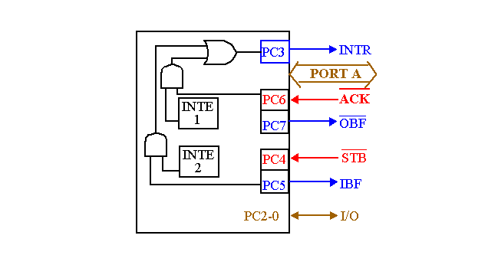
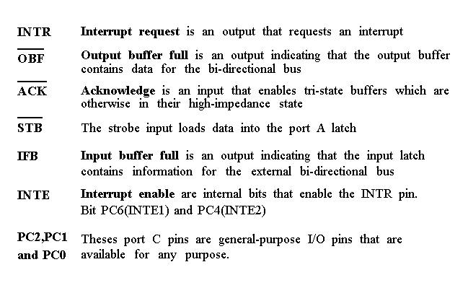
8255 PPI Contd.
Timing diagram is a combination of the Mode 1 Strobed Input and Mode 1 Strobed Output Timing diagrams.
*

Slide 30
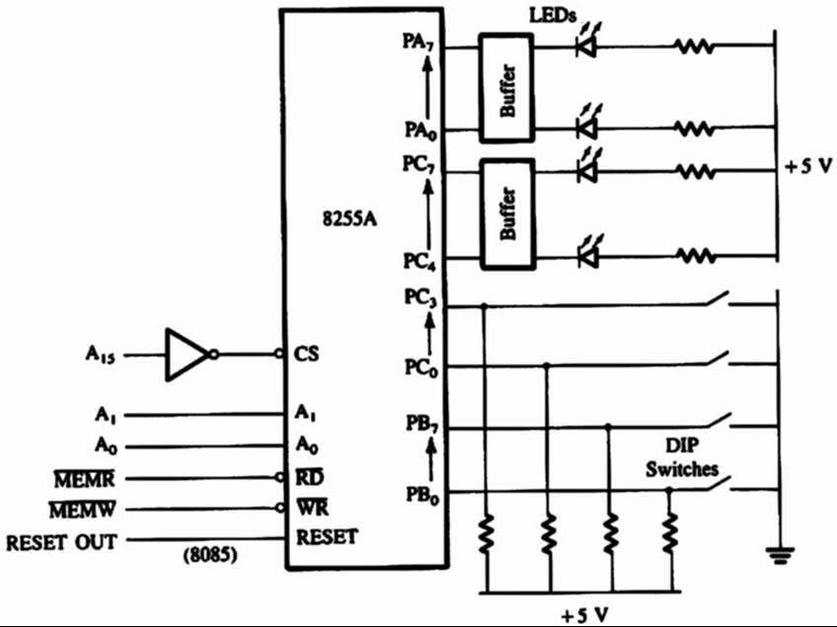
8255 PIA : Mode 0
Mode 0: Input / Output Mode
Example :
Determine the port address of circuit.
Determine the control word in Mode 0, in order to determine ports A and C_{U} as output port and ports B and C_{L} as input ports.
Write a program to read DIP switch and display the reading from port B to port A, from port C_{L} to port C_{U}.
*

Slide 31
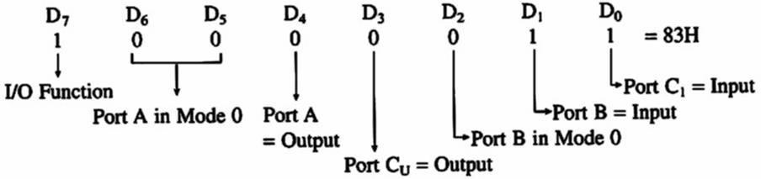
8255A Programmable Peripheral Interface
Solution:
Control Word:
*

Slide 32
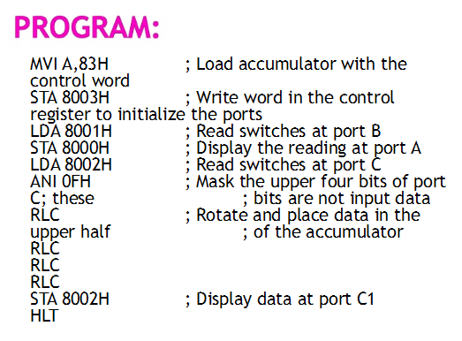
Write a program to read the DIP switches and display reading from port B at port A and from port C_{L} at port C_{U}
*

